Slide 1
Modelleren en Systeemontwerp
Development process

Slide 2
Development process
How to manage the process of constructing complex software?
In areas such as physics, there are fixed methodologies for experiments and measurements
This translates into concrete processes for engineering disciplines, such as architecture
But what about Computer Science?

Slide 3
Waterfall model
REQUIREMENTS ANALYSIS
(Royce, 1970)
DESIGN
CODING AND DEBUGGING
TESTING AND VERIFICATION
MAINTENANCE

Slide 4
Criticism on the waterfall model
Traditionally, the waterfall model aims to complete every phase before moving on to the next
Critics complain that the waterfall model is not robust against change
A client can change his mind halfway through the project
The money can run out
A design can turn out to be too costly or complex to implement
“Many of the [system's] details only become known to us as we progress in the [system's] implementation. Some of the things that we learn invalidate our design and we must backtrack.” - David Parnas

Slide 5
Alternatives to the waterfall model
The (Rational) Unified Process (RUP)
Extreme Programming
Agile/Scrum
Kanban
Do whatever
PRESCRIPTIVE
ADAPTIVE

Slide 6
About the software development process
Managing software development is a hard problem
Choosing a methodology is a bit like choosing an operating system or text editor:
Each system is slightly different
There is no clear winner
There are zealous advocates for each system
My advice:
Choose the right tool for the job
Don’t be afraid to experiment
Don’t worry about the process, worry about the execution

Slide 7
The (RATIONAL) unified process
In this course, we will stick to one methodology, and how it meshes with the ideas of object orientation
We focus on the Rational Unified Process (Jacobson, Booch and Rumbaugh, 1999)
It is still a popular philosophy today
Not as ‘cool’ as Agile/Scrum or Kanban
But components of RUP can be adapted to work with other methodologies, so it is a nice foundation

Slide 8
The unified process
The Unified Process emphasizes iterative software development
Develop software in time-boxed mini-projects called iterations
Each iteration has clearly defined milestones, including a tested, integrated, executable system

Slide 9
Iterative development - philosophy
The iterative lifecycle is based on the successive enlargement and refinement of a system though multiple iterations with feedback and adaptation
The system grows incrementally over time, iteration by iteration
The system may take many iterations to be production ready (or ready for deployment)

Slide 10
Iterative development - implementation
The output of an iteration is not (just) an experimental prototype but a production subset of the final system
Each iteration tackles new requirements and incrementally extends the system
An iteration may occasionally revisit existing software and improve it

Slide 11
Embracing change
Stakeholders usually have changing requirements
End users
Project management
Upper management
Implementors
Testers
. . .
Each iteration involves choosing a small subset of the requirements and quickly design, implement and test them
This leads to rapid feedback, and an opportunity to modify or adapt understanding of the requirements or design

Slide 12
Unified process - phases
UP defines four different phases, each split into multiple iterations:
Inception - Define the scope of the project
Elaboration - Plan the project, specify features, baseline architecture
Construction - Finish the construction
Transition - Hand over the project to end users
Each phase overlaps with some elements of the waterfall model, ...
but the balance between them shifts as time passes.

Slide 13
Unified process – best practices
Develop software iteratively and involve users early
Manage requirements
Visually model software (UML)
Verify software quality - test, code reviews, release in every iteration
Embrace change

Slide 14
UP versus Agile
The Agile Manifesto
"We are uncovering better ways of developing software by doing it and helping others do it. Through this work we have come to value:"
Individuals and interactions over processes and tools
Working software over comprehensive documentation
Customer collaboration over contract negotiation
Responding to change over following a plan

Slide 15
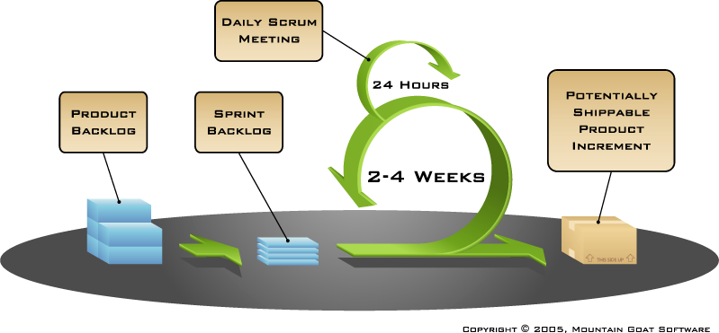
Agile software development with scrum

Slide 16
UP vs Agile
UP is an iterative top down approach
The aim of UP is to minimize change by carefully thinking about requirements and design before implementing anything
Agile is an iterative top down, bottom up approach
The aim of Agile is to minimize work for developers, by releasing prototypes quickly and involving the users in each iteration

Slide 17
Unified process
Today we will see an overview of the UP…
…but applying the UP to your own projects is your responsibility
This session is mostly focused on the first two stages of the UP: Inception and Elaboration

Slide 18

Inception

Slide 19
Inception
Envision the product scope, vision, and business case
Upon completion, the stakeholders have a basic agreement on the vision of the project and are able to decide whether to continue or not
It typically only lasts a few weeks

Slide 20
Inception – Artifacts
A vision document - what is the general vision of the project and what are the key features and constraints?
A initial list of use-cases - how will end-users interact with the system?
An initial project glossary - what is some of the domain-specific lingo?
An initial business case - how will we make money?
An initial risk assessment - what might go wrong?
A project plan, showing phases and iterations - how will we move forward?
One or several prototype experiments

Slide 21
Inception – what it is and what it isn’t
It's not about deciding how many weeks feature X will take to implement
You need a ballpark estimate: 1 month or 1 year? 1M or 10K euros?

Slide 22
Inception – what it is and what it isn’t
It's not about identifying every possible interaction that every imaginable user can have with your system
You want to have an idea of which people will end up using the system
You should have a few carefully thought out use cases

Slide 23
Inception – what it is and what it isn’t
It's not about choosing the color of the icon, which GUI library to use, or which operating system to support
You do want to think about whether it will run on tablets, mobile phones, desktops, or in the cloud

Slide 24
About risk
It can be very hard to identify where the risks lie in any project:
Example: changing the limit on a credit card
Example: restaurant matching website

Slide 25
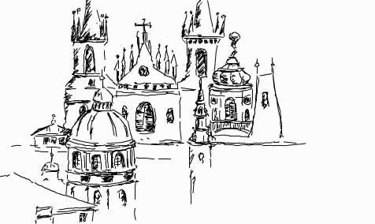
Elaboration

Slide 26
Elaboration – Goals
Analyze the problem domain, establish an architectural foundation, develop a project plan, and eliminate highest risks
You need to develop a ‘mile high and inch deep’ view of the system
Now is the time to make architectural decisions
Build an executable architecture prototype, thereby eliminating critical risk, for the central use cases developed in the Inception phase
Note: you should start building a prototype early, even if the requirements have not been finalized yet

Slide 27
Elaboration – artifacts
A use-case model describing how users will interact with the system
Supplementary requirements capturing the non-functional requirements
A Software Architecture Description
...a what?

Slide 28
Software architecture
Software Architecture is a very popular term in the context of software development
From Larman (p. 448):
[…] the architecture includes the organization and structure of the major elements of the system. Beyond this static definition, it includes the system behavior, especially in terms of large scale responsibilities of systems and subsystems, and their collaborations. In terms of a description, the architecture includes the motivations or rationale for why the system is designed the way it is.

Slide 29
Elaboration – artifacts
A use-case model describing how users will interact with the system
Supplementary requirements capturing the non-functional requirements
A Software Architecture Description
A revised risk list and a revised business case
A development plan for the overall project, including the coarse-grained project plan, showing iterations and evaluation criteria for each iteration

Slide 30
Elaboration – results
A stable vision of the software system and its architecture
Minimized the risks that could cause the project to fail if you choose to continue
Better estimates for project costs and planning

Slide 31

Construction

Slide 32
Construction – goals
The main goal of the construction phase is to develop and test a baseline product
Upon completion, there should be a clear description of the product status, together with user manuals. The tool should be ready to be deployed - even if not all features are fully implemented.

Slide 33

Transition

Slide 34
Transition
The transition aims to deliver the first version of the software to its users
Beta testing
Training of new users and maintainers
Operating in parallel with existing legacy systems
Legacy issues: e.g. conversion of databases
. . .
This process usually involves a lot of tuning, bug-fixing, processing enhancement requests, and implementing unfinished features

Slide 35
Transition – goals
Enabling users to use your product
Achieving consensus with all stakeholders that the baseline product is complete
Iteratively refining the baseline until the final product is implemented

Slide 36
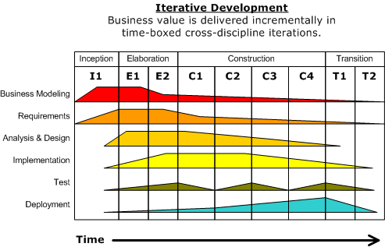
Unified process – phases in time

Slide 37
Activities
UP identifies six distinct kinds of `engineering activity’
Business modeling
Requirements engineering
Analysis & Design
Implementation
Test
Deployment
And three kinds of ‘supporting’ activities:
Project management work
Configuration and change Management
Environment: development kit, tools for building and process control
For now, we will focus on the first three engineering activities

Slide 38
The first three engineering activities
Business Modeling aims to document existing business processes to establish a common understanding between various stakeholders about how the organization works
Requirements Engineering aims to describe what the system should do, allowing customers and developers to agree on that description
Analysis and Design aims to describe how the system should be implemented, in accordance with the requirements it should satisfy

Slide 39
Material covered
Rational Unified Process Whitepaper - available via Blackboard
Craig Larman. Applying UML and Patterns. Pearson Education. 2002. Chapters 1-4

